Slide 1

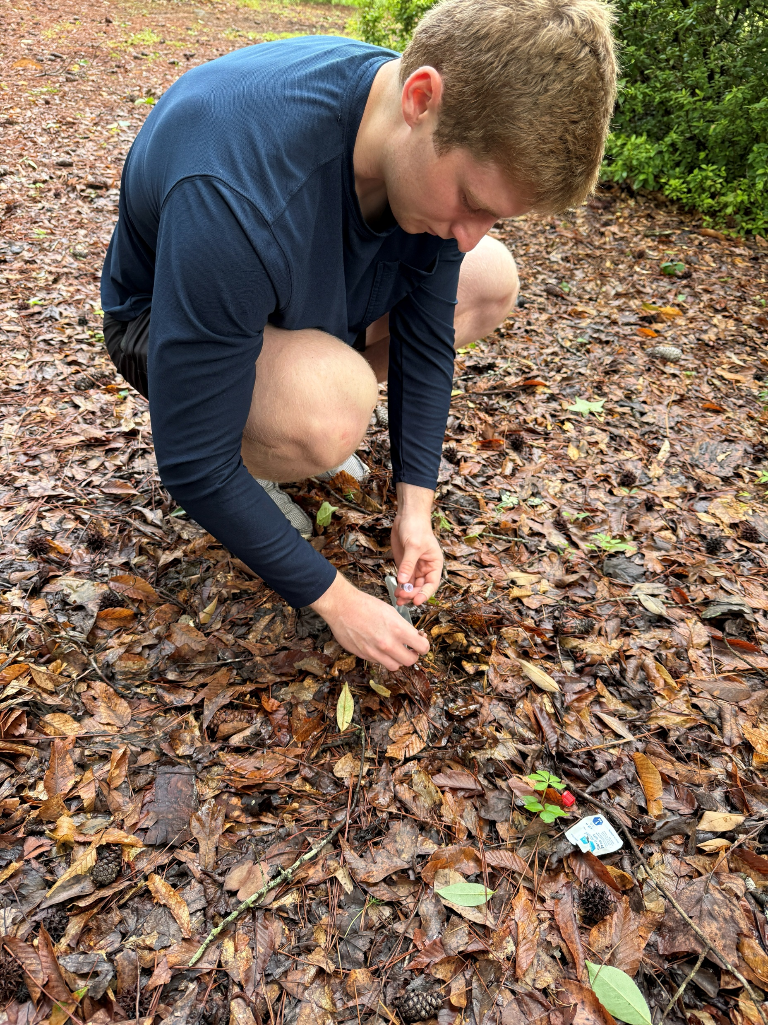
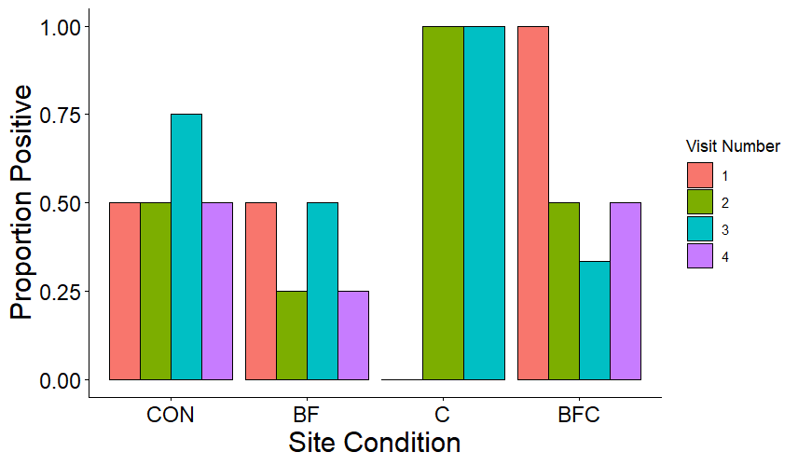
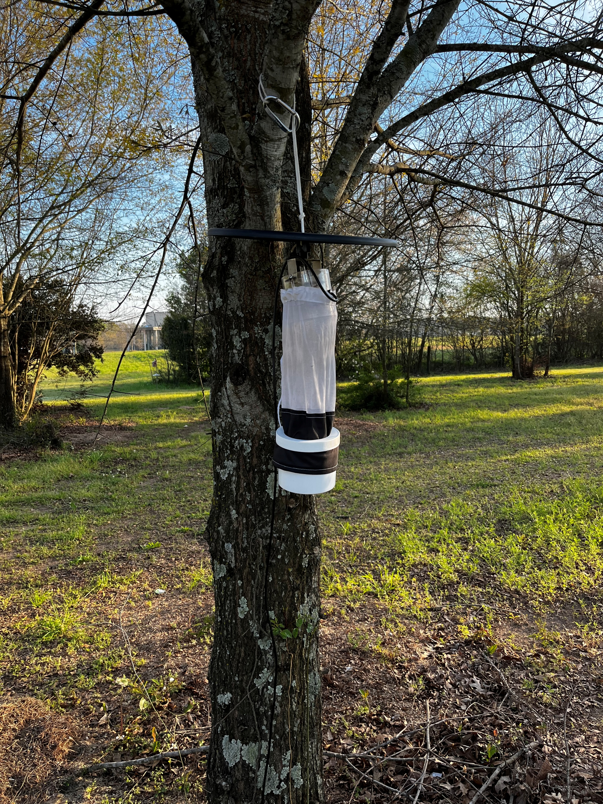
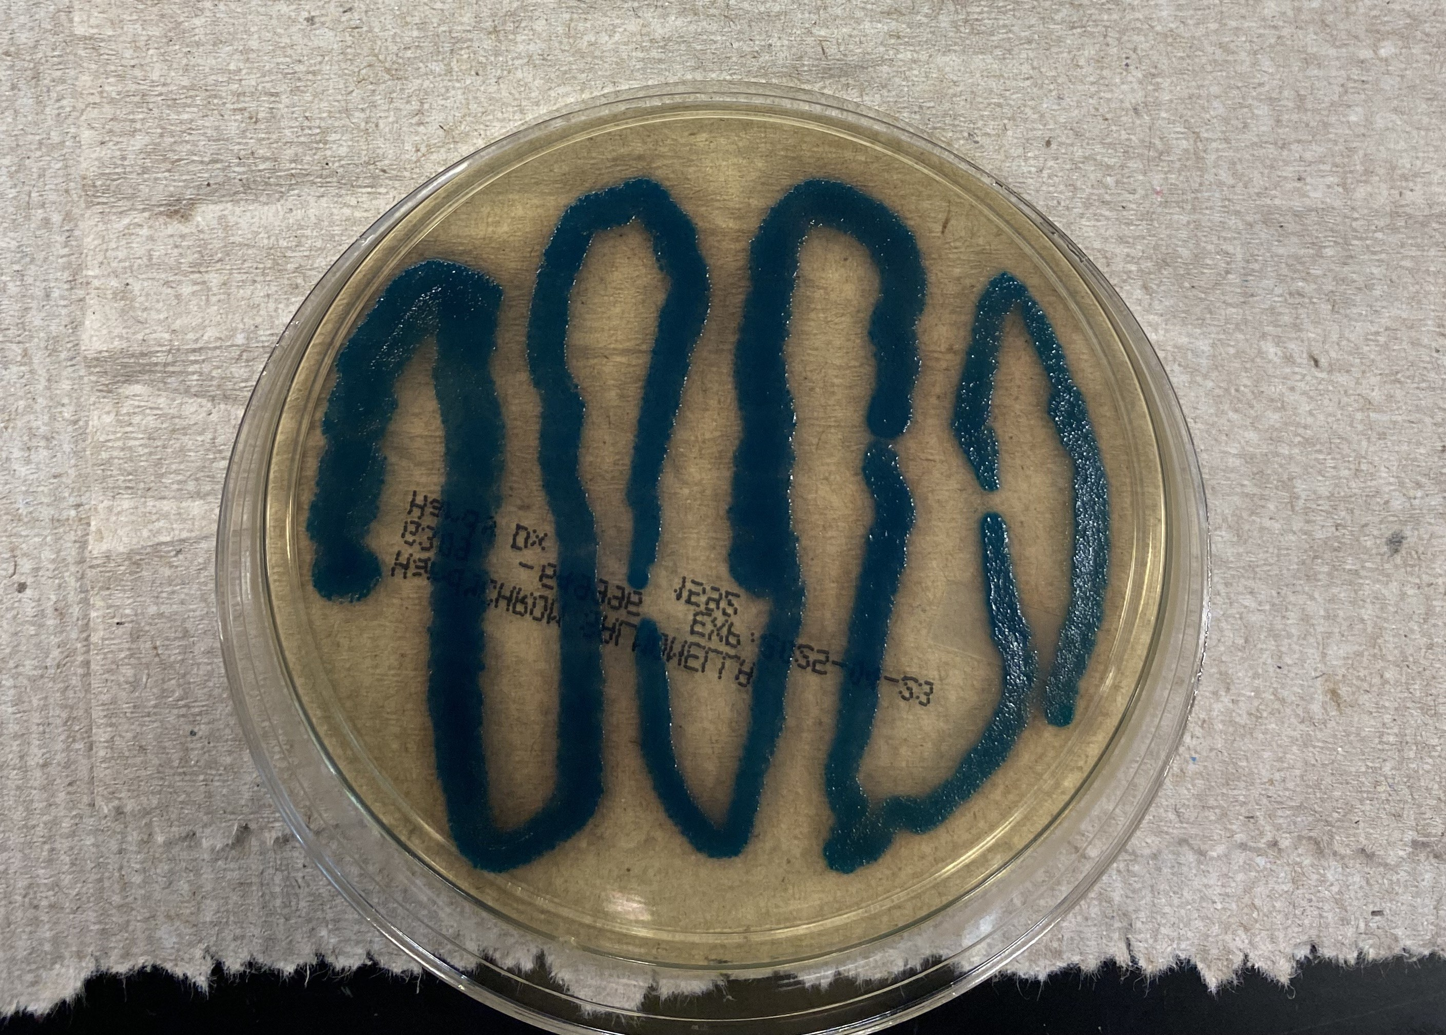
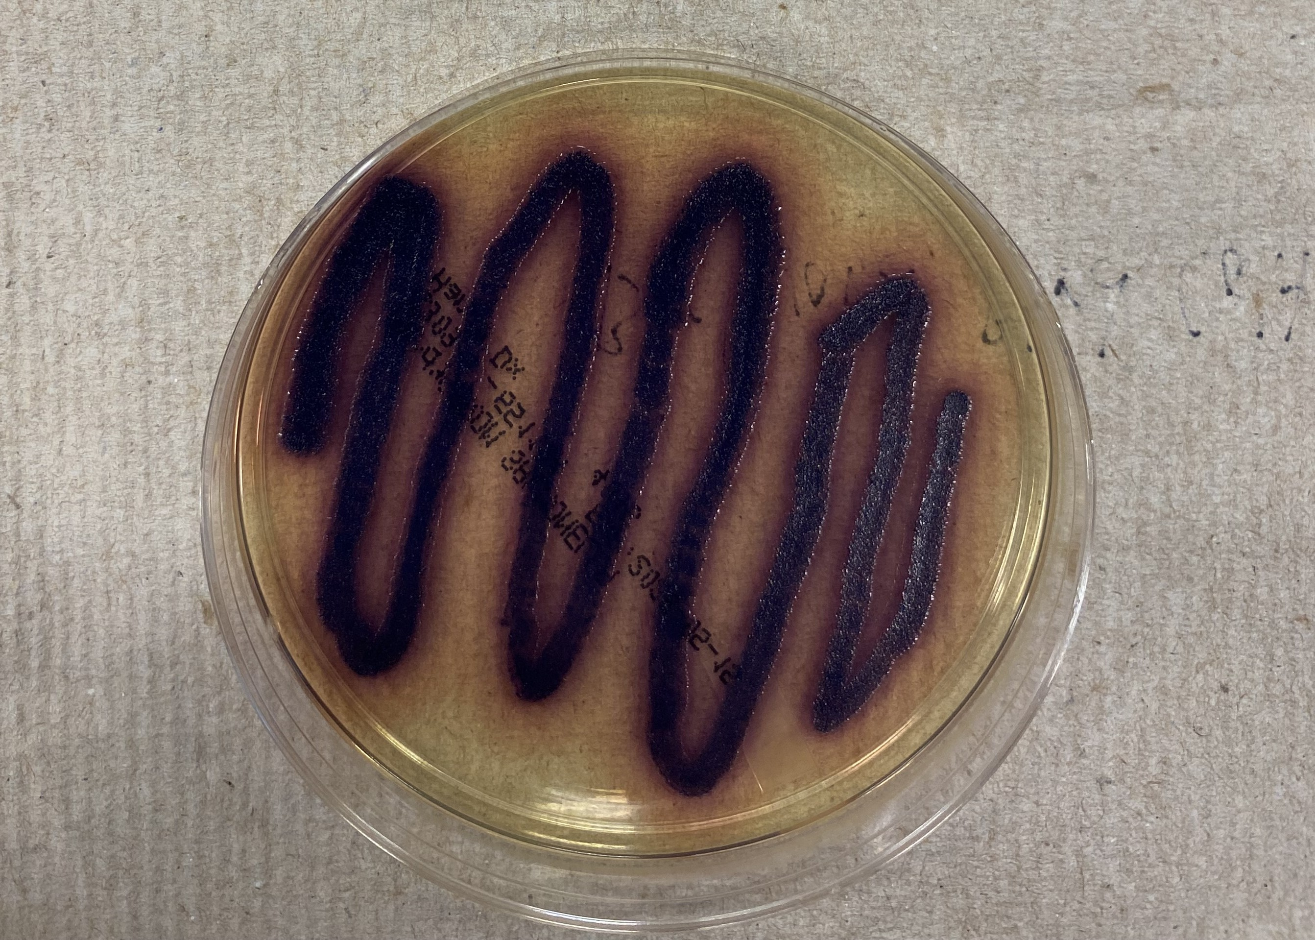
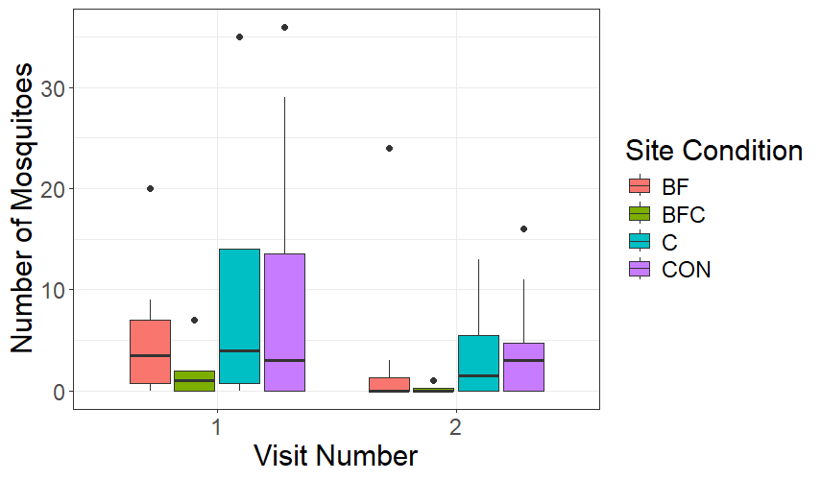
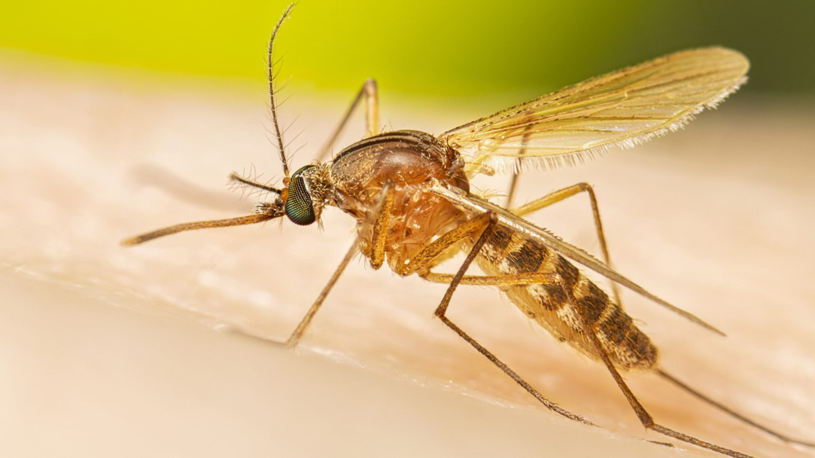
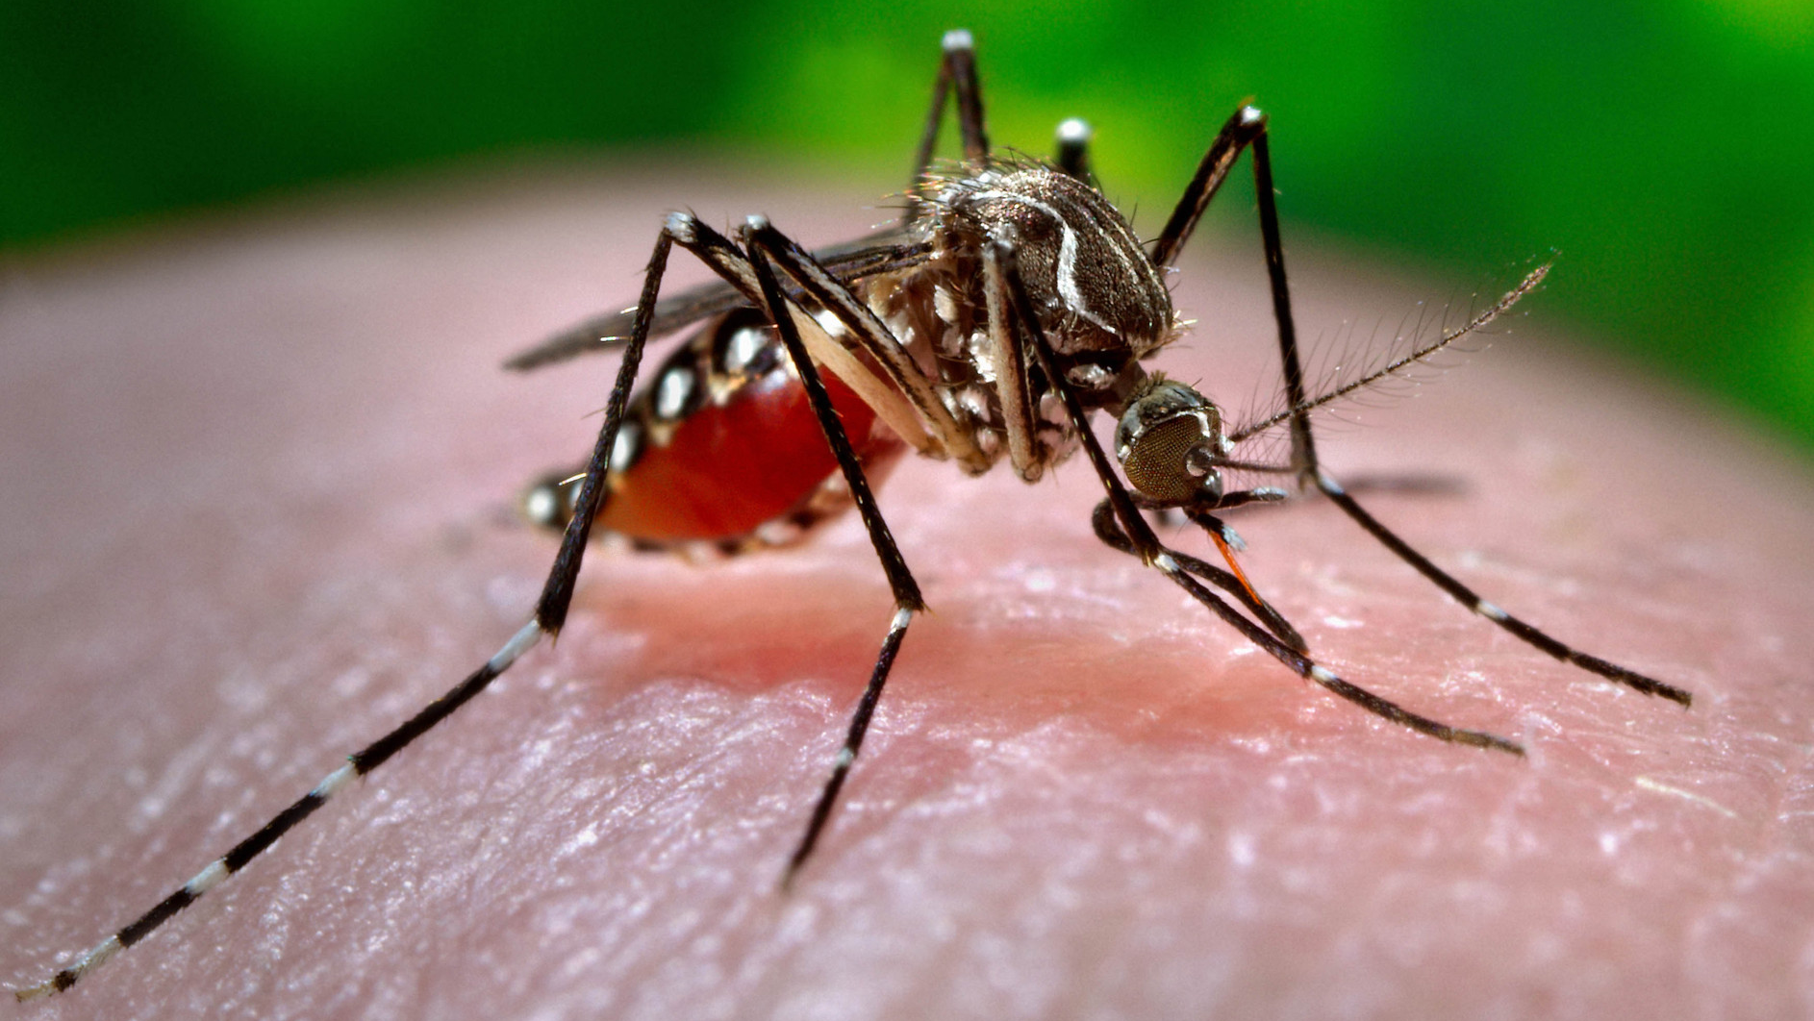
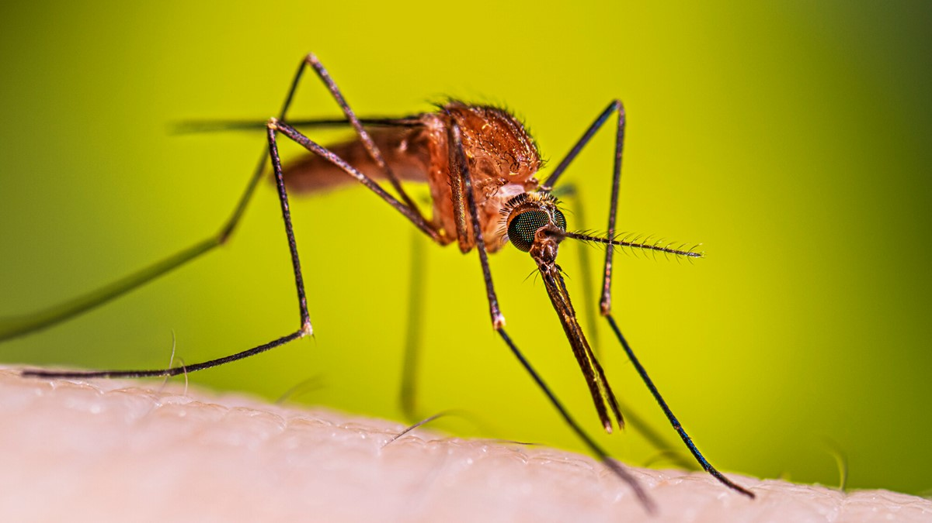
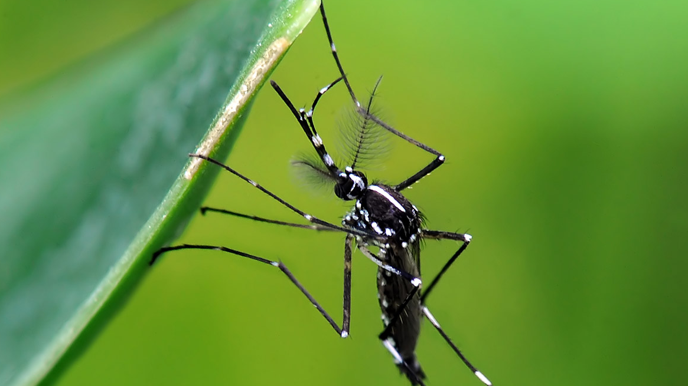
Quantifying Salmonella enterica and Escherichia coli persistence in backyard environments
Luke Watters¹, Aniruddha Belsare^{1,2}, Tabeth Mwema¹, Alex Fisher¹, Grace Southerland¹, Janna Willoughby¹ and Kelsey McCune¹
Auburn University College of Forestry, Wildlife, and Environment and 2. College of Veterinary Medicine
Introduction
Methods
Results
Conclusions
Bird feeding & poultry activities increase disease [1]
May promote environmental persistence of S. enterica and E. coli [2]
Backyards also support mosquitoes [3, 4] that are vectors for West Nile Virus, Zika, avian malaria [5, 6, 7]
We evaluated bacterial persistence and mosquito patterns across different yard activities
No one mosquito genus was more prevalent than the others
Number of mosquitoes in was fewer than other sites
No differences in bacterial prevalence among site conditions
Backyard activities may impact mosquito, but not bacterial presence
Future plans:
1. Finish processing S. enterica
2. Collect samples over different seasons
+
Environmental sample collection
CO₂-baited fan traps used to catch mosquitoes
+
Figure 1. No difference in bacteria in each site condition over time.
Methods
Sites:
Environmental samples collected biweekly beneath feeders or coops
Cultured for bacteria
Mosquitoes collected twice per site using CO₂-baited fan traps
E. Coli positive agar plate
S. Enterica positive agar plate
+
References
+
Jones, K. E., Patel, N. G., Levy, M. A., Storeygard, A., Balk, D., Gittleman, J. L., & Daszak, P. (2008). Global trends in emerging infectious diseases. Nature, 451(7181), 990–993. https://doi.org/10.1038/nature06536
Tizard, I. (2004). Salmonellosis in wild birds. Seminars in Avian and Exotic Pet Medicine, 13(2), 50–66. https://doi.org/10.1053/j.saep.2004.01.008
Shragai, T., Tesla, B., Murdock, C. and Harrington, L.C. (2017), Zika and chikungunya: mosquito-borne viruses in a changing world. Ann. N.Y. Acad. Sci., 1399: 61-77. https://doi.org/10.1111/nyas.13306
Nabi, G., Wang, Y., Lü, L., Jiang, C., Ahmad, S., Wu, Y., & Li, D. (2021). Bats and birds as viral reservoirs: A physiological and ecological perspective. Science of The Total Environment, 754, 142372. https://doi.org/10.1016/j.scitotenv.2020.142372
Bernard KA, Maffei JG, Jones SA, Kauffman EB, Ebel G, Dupuis AP 2nd, Ngo KA, Nicholas DC, Young DM, Shi PY, Kulasekera VL, Eidson M, White DJ, Stone WB, Kramer LD; NY State West Nile Virus Surveillance Team. West Nile virus infection in birds and mosquitoes, New York State, 2000. Emerg Infect Dis. 2001 Jul-Aug;7(4):679-85. doi: 10.3201/eid0704.010415. PMID: 11585532; PMCID: PMC2631772.
Armstrong PM, Andreadis TG. Eastern equine encephalitis virus in mosquitoes and their role as bridge vectors. Emerg Infect Dis. 2010 Dec;16(12):1869-74. doi: 10.3201/eid1612.100640. PMID: 21122215; PMCID: PMC3294553.
LaPointe, D.A., Atkinson, C.T. and Samuel, M.D. (2012), Ecology and conservation biology of avian malaria. Annals of the New York Academy of Sciences, 1249: 211-226. https://doi.org/10.1111/j.1749-6632.2011.06431.x
Centers for Disease Control and Prevention. (2025). Culex mosquito [Photograph]. CDC. About Culex Mosquitoes | Mosquitoes | CDC
Centers for Disease Control and Prevention. (2024). Anopheles mosquito [Photograph]. CDC. Life Cycle of Anopheles Mosquitoes | Mosquitoes | CDC
VDCI Mosquito Management. (2026). Aedes aegypti mosquito [Photograph]. VDCI. The Challenges in Managing Aedes Aegypti
JuzaPhoto. (2015). Aedes albopictus mosquito. [Photograph]. JuzaPhoto. Aedes albopictus | JuzaPhoto
Culex mosquito. Source: CDC, 2025 [8]
Aedes aegypti mosquito. Source: VDCI, 2026 [10]
Acknowledgements
We thank LeeAnn Bailey, Dianna Bourassa, Matthew Bailey and the homeowners
Anopheles mosquito. Source: CDC, 2024 [9]
Aedes albopictus mosquito. Source: JuzaPhoto, 2015 [11]
Figure 2. Fewer mosquitoes in bird feeder + chicken houses.

